Slide 1
ASP.NET
Models

Slide 2
Agenda
Introduction
Getting Started
Angular CLI
Project Overview
Debug Tools
Dependency Injection

Slide 3
IoC
1
Introduction + Problem without IoC

Slide 4

Problem
How can I help?

Slide 5
Problem
Can we see mrs Lucia Peeters

Slide 6
Problem
Can we see mrs Lucia Peeters
DEPENDENCY

Slide 7
Problem
Can we see mrs Lucia Peeters
DEPENDENCY
What if Lucia Peeters is unavailable?
Who will help us?

Slide 8
Problem
How can I help?

Slide 9
Problem
Can we see someone from the BeOne Team

Slide 10
Problem
Let me check?

Slide 11
Problem
Bart will meet you in a few minutes?

Slide 12
public class PersonController : Controller
{
SQLRepository _repo = new SQLRepository();
public IActionResult Index()
{
List<Person> persons = _repo.GetPersons();
return View(persons);
}
public IActionResult Details(int id)
{
Person p = _repo.GetPersonById(id);
if(p == null)
{
throw NotFoundViewResult("Person not found");
}
}
}

Slide 13
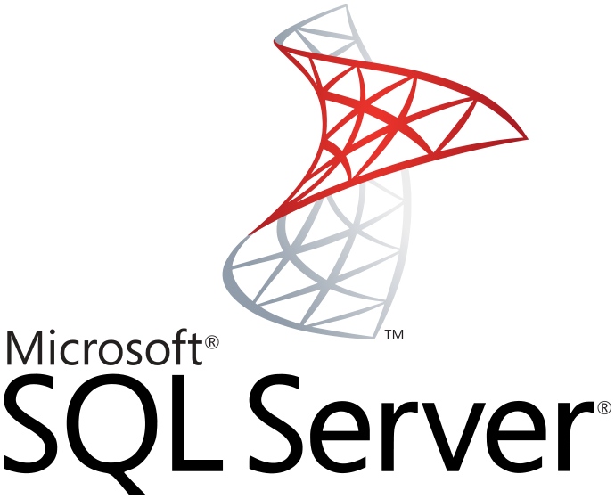


Slide 14
Persons

Slide 15
Travel
Suppliers
Logs
Courses
Errors
Relatives
Products
Persons
Invoices
Auth
Types
Addresses
Statusses
Categories
Roles

Slide 16
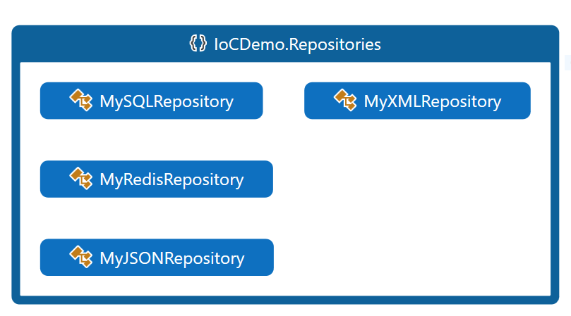

Slide 17
IoC
1
Introduction + Solution with IoC

Slide 18
STEP 1: the constructor sets the functionality
SQLRepository _repo;
public PersonController(SQLRepository repo)
{
this._repo = repo;
}
Still SQL

Slide 19
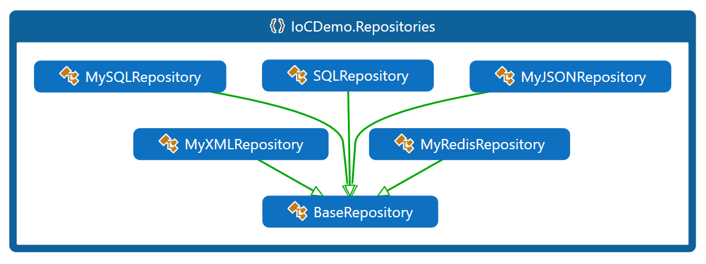

Slide 20

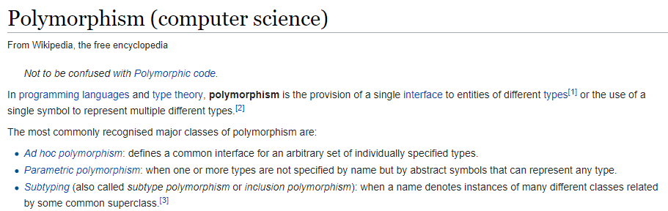
Polymorphism

Slide 21
BaseRepository sql = new SqlRepository();
BaseRepository mysql = new MySqlRepository();
BaseRepository oracle = new OracleRepository();
Repository can have different shapes
as long as they all inherit from BaseRepository
Polymorphism

Slide 22
Polymorphism
SQLRepository _repo;
public PersonController(SQLRepository repo)
{
this._repo = repo;
}

Slide 23
Polymorphism
SQLRepository _repo;
public PersonController(SQLRepository repo)
{
this._repo = repo;
}

Slide 24
Polymorphism
_repo;
public PersonController( repo)
{
this._repo = repo;
}

Slide 25
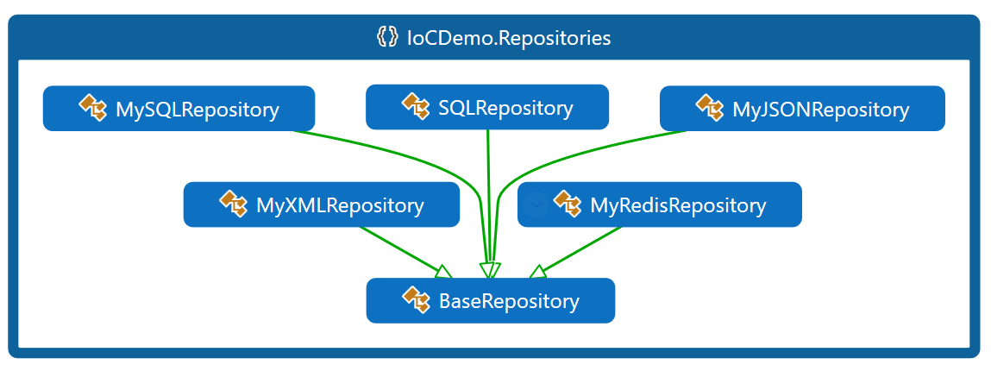

Slide 26
Polymorphism
BaseRepository _repo;
public PersonController(BaseRepository repo)
{
this._repo = repo;
}

Slide 27
Polymorphism
This class has no single responsibility
Responsibilities are injected via a middleman
BaseRepository _repo;
public PersonController(BaseRepository repo)
{
this._repo = repo;
}
DEPENDENCY INJECTION

Slide 28
Who is the middleman or middlewoman

Slide 29
Who is the middleman or middlewoman

Slide 30
Who is the middleman or middlewoman in ASP/NET
Startup.cs
public void ConfigureServices(IServiceCollection services)
{
services.AddMvc();
services.AddTransient<BaseRepository,SQLRepository>();
}

Slide 31
Who is the middleman or middlewoman in ASP/NET
Startup.cs
public void ConfigureServices(IServiceCollection services)
{
services.AddMvc();
services.AddTransient<BaseRepository,SQLRepository>();
}
When someone asks for a Repository,
pass SQLRepository

Slide 32
Who is the middleman or middlewoman in ASP/NET
Startup.cs
public void ConfigureServices(IServiceCollection services)
{
services.AddMvc();
services.AddTransient<BaseRepository,MySQLRepository>();
}
When someone asks for a Repository,
pass MySQLRepository

Slide 33
STEP 2: use services
A repository is a link to our database,
Better create a layer of services in between
WEB
PersonService
Repositories
ProductService
data
InvoiceService
CategoryService

Slide 34
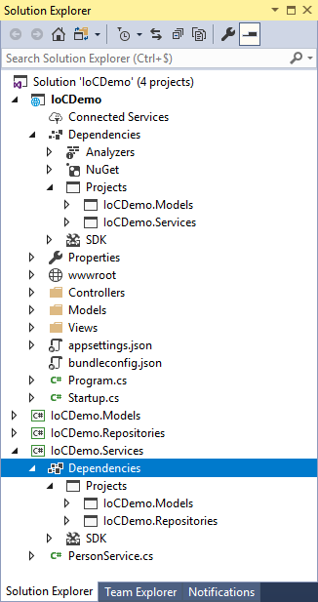

Slide 35
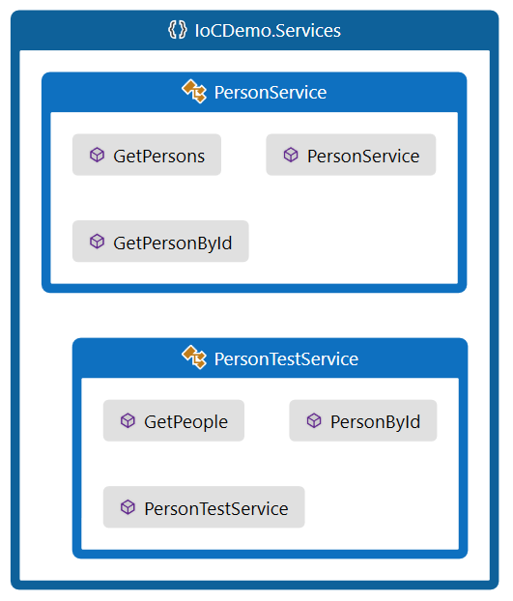

Slide 36
How do we make sure that every repository has the same methods?

Slide 37
Interfaces

Slide 38
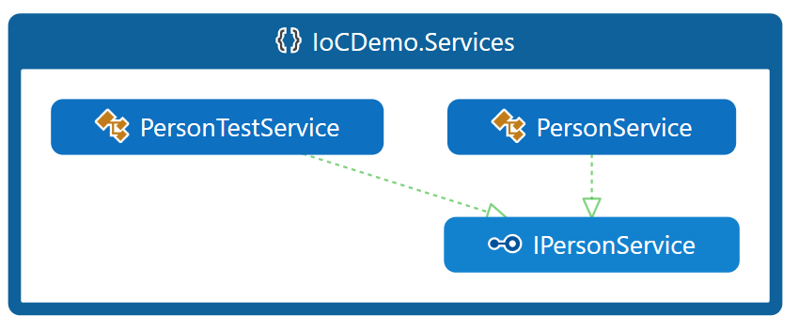

Slide 39
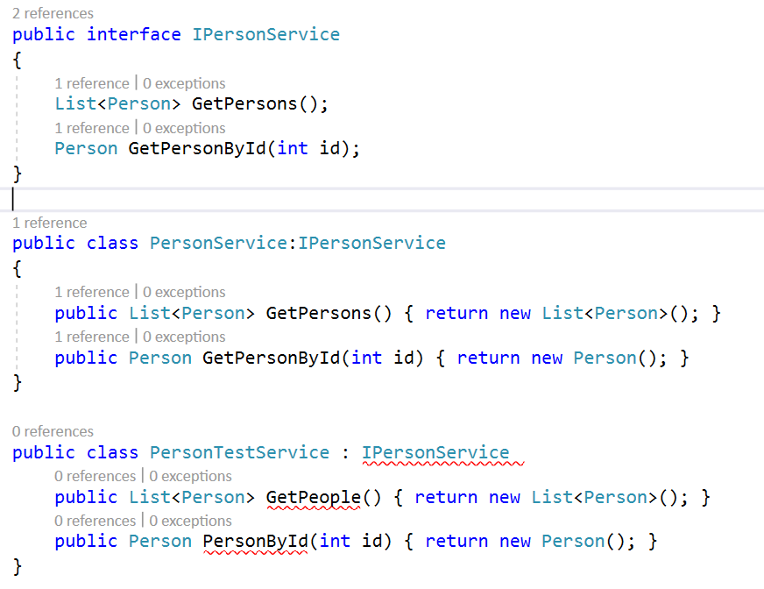

Slide 41
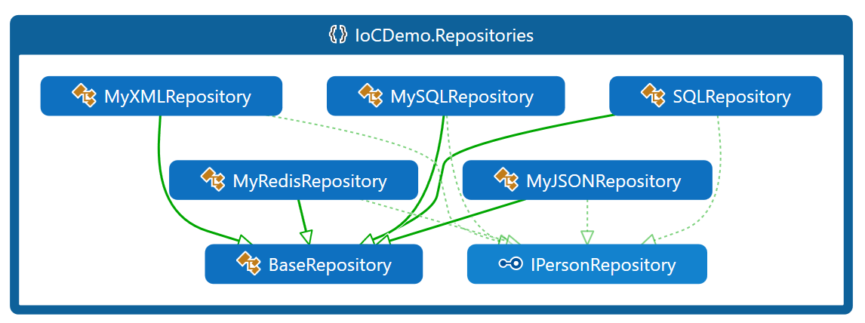

Slide 42
IPersonRepository _repo;
public PersonsController(IPersonRepository repo)
{
this._repo = repo;
}

Slide 43
public void ConfigureServices(IServiceCollection services)
{
services.AddMvc();
services.AddTransient<IPersonService, PersonService>();
services.AddTransient<BaseRepository,SQLRepository>();
}

Slide 44
IoC
3
Scopes

Slide 45
Scopes
Transient
New instance is created everytime they are requested
Best for lightweight, stateless services
Scoped
Created once per request
Singleton
Created the first time they are requested
From then, every request uses the same instance

